Slide 1
Agile Community AgilePM (DSDM) vs Scrum
July 2021

Slide 2
What is DSDM?
Dynamic System Development Method
Covered under
AgilePM Foundation (2 Days)
AgilePM Practitioner (Requires Foundation + 3 Days) – Needs renewing after 5 years.

Slide 3
Manifesto for Agile Software Development
Individuals and interactions over process and tools
Working software over comprehensive documentation
Customer collaboration over contract negotiation
Responding to change over following a plan.
While there is value in the items on the right, we value the items on the left more.
DSDM = SCRUM Manifesto

Slide 4
DSDM VS SCRUM Principals
Eight principals in DSDM
Focus on the Business Need
Deliver on Time
Collaborate
Never Compromise Quality
Build Incrementally from Firm Foundations
Develop Iteratively
Communicate Continuously and Clearly
Demonstrate Control
Six principals in SCRUM
Empirical Process Control
Self-organisation
Collaboration
Value Based Prioritisation
Time-boxing
Iterative Development

Slide 5
Deliver on Time - Project Variables
Four key project variables:- Time, Quality, Cost and Features
Standard Model
DSDM Model
Features
Time
Cost
Fixed
Quality
Quality
Variable
Time
Cost
Features

Slide 6
Never Compromise on Quality
How do you control what features need delivering?
MoSCoW –MUST have, SHOULD have, COULD have, WONT
If there are unknowns, make sure that a reasonable margin is added to your time to cover the MUSTS as a minimum!
Estimation and ticket writing tools are apart of DSDM by default.
SCRUM comes in after project variable considerations, however, it does set a standard for the quality of the features and provides a focus on how features will be delivered.

Slide 7
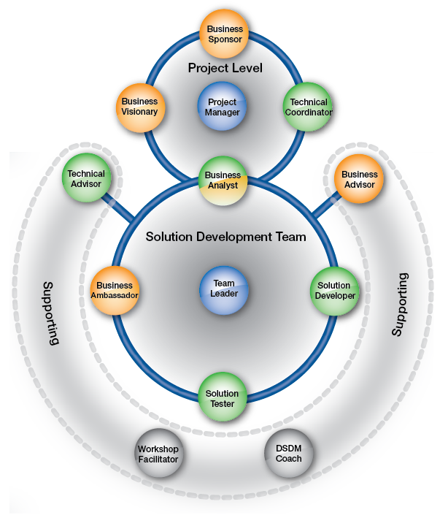
DSDM - Roles
Role Categories
Orange – Business Interests
Green – Solution/technical interests
Blue – Management Interests
Grey – Process Interests
Mixed – Mixed Interests
A single individual can have multiple roles and in some cases is recommended except for the Business Visionary.
A project does not need to include every position, in fact that would go against SCRUM (Team < 10)

Slide 8
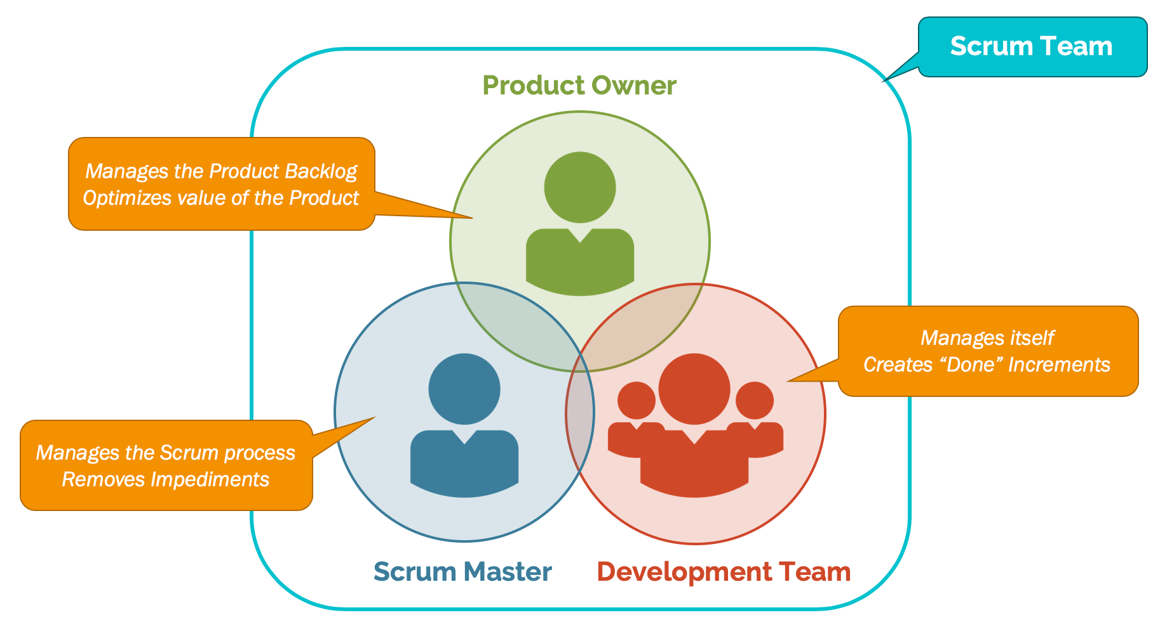
DSDM - Roles (Scrum Conflicts)
Single focus is not a requirement
Teams are not truly self organising, everyone has a main role.
Some roles do not fit into the Scrum Roles
PM does not exists
Where do Business interest roles go since there should only be one Product Owner.
Two types of management interest roles… two Scrum masters on every team.
DSDM coach = Scrum Master, not a main team role.

Slide 9
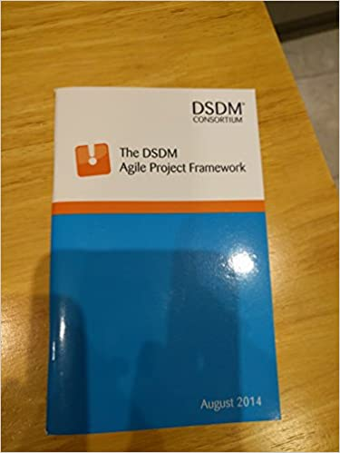
Course Material + Recommendations
If you can find a copy of the DSDM Consortium Handbook, grab it. It is provided on the course for free.
Interested in team processes – SCRUM
Interested in Roles and the bigger project picture – AgilePM Foundation

Slide 10
Let’s talk!
Scott.alexander@civica.co.uk

